Slide 1

Home Healthcare Website Development
Group Assignment 2- Product Backlog & Release Planning Shabaz Sharieff, Haaris, Nilkanth Parsi, Kuldeep Owalekar, Vandna Mehta.
Instructor : Prof. Mary Reese
June 3, 2023

Slide 2
Link
https://sharieff.atlassian.net/jira/software/projects/HHWT6/boards/2/roadmap?selectedIssue=HHWT6-3

Slide 3
Agenda
About Us
Product vision
What We Offer
Road map
Release plan
Product backlog
References

Slide 4

About Us
Our healthcare website aims to provide convenient access to top-notch healthcare services, ensuring that users can easily avail themselves of high-quality healthcare from the convenience of their own homes.

Slide 5
Product vision
Our goal is to transform the healthcare experience by addressing individual needs through thoughtful solutions, ultimately contributing to a superior and more health-conscious world.

Slide 6
What we offer
Continuous support
Cost-effectiveness
Smooth patient experience
Convinient access to information
Enhanced coordination and personalization of care

Slide 7

Road map
ROADMAP FOR DEVELOPING HOME HEALTHCARE WEBSITE THROUGH 4 SPRINTS OF 2 WEEKS EACH.
TASKS FOR EACH SPRINT BASED ON PROJECT OBJECTIVES AND CUSTOMER FEEDBACK.
DIVIDED ROADMAP INTO EPICS OF PAGES, SERVICES, AND FUNCTIONALITIES.

Slide 8
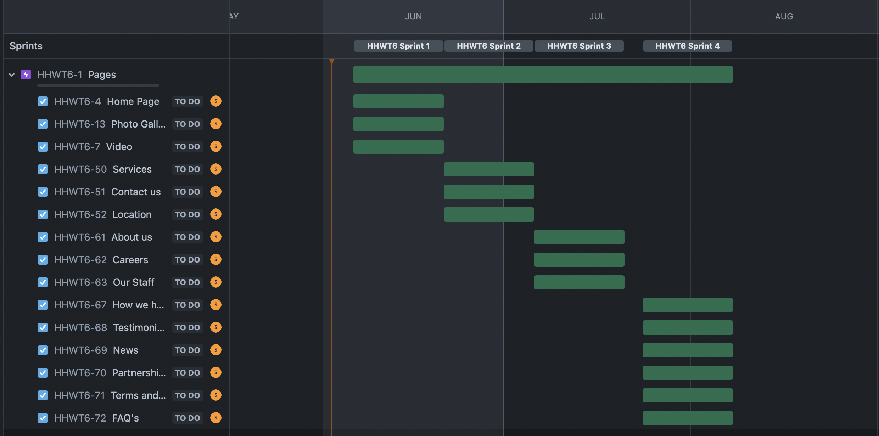
Roadmap - Pages
You can find the Roadmap here: https://sharieff.atlassian.net/jira/software/projects/HHWT6/boards/2/backlog

Slide 9
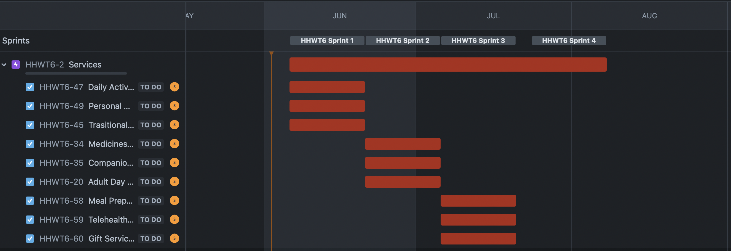
Roadmap - services

Slide 10
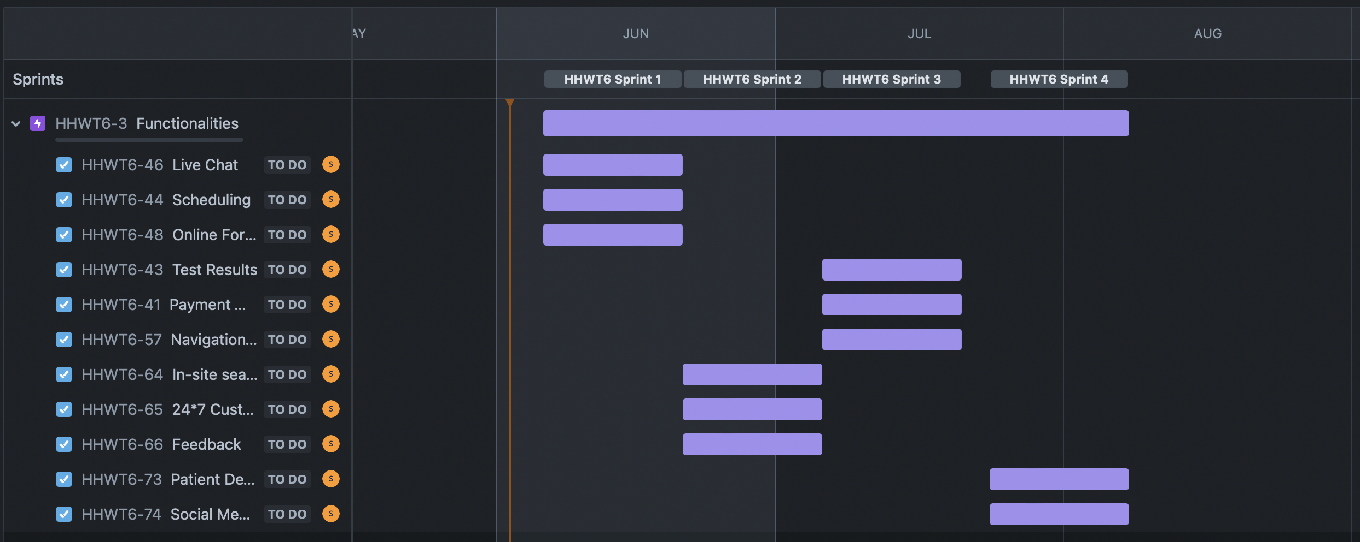
Roadmap - Functionalities

Slide 11
Release plan
Create and test tasks for Customer Support and Medicines Delivery information.
Create and test jobs connected to the web page's end, such as contact information, careers, payments, and so on.
Create and test assignments using employees and social media data.
Create and test jobs for Site websites, Sterility, Regimen, and so on.
A release plan is a roadmap that outlines expectations for the features that will be added and their completion dates.
Depending on the development strategy, the goal may be to produce a release once a specific set of functionality has been developed, or the planning may be date-driven, in which case the release takes place at a specific checkpoint.
Sprint 1
Sprint 2
Sprint 3
Sprint 4

Slide 12
Release | Home Healthcare Website With Basic Functionalities
Release Goal | The goal of the release is to make a complete, easy-to-use platform that makes it easy for users and service providers in the home healthcare business to talk to each other. By adding features in small steps, we hope to provide value at each stage and get feedback from users to keep making improvements.
Release Scope | User –friendly Website with proactive Customer Support In-site Search, Test Result, Live Chat, and Open Forum among key functionalities Dashboard for users to handle bookings, look at past appointments and change their own information. Improved accuracy and effectiveness of search results. Website promotion using social media.

Slide 13
SPRINT 1
Planning & Designing | Duration
Define the product roadmap and prioritize the product backlog | Week 1-2
Identify User base and requirements and reviews | Week 3
Design Website UX and app mockup | Weeks 4-7
Include basic functionality plan | Week 8
Documentation & Approval | Week 9

Slide 14
SPRINT 2
Development & Execution | Duration
Create the Website’s Dashboard and front-page | Week 10
Work on Website back-end | Week 11
Develop a dashboard that service providers can use to manage their listings, appointments, and profile information. | Weeks 12
Add advanced filters such as price range, rating, and service provider qualifications to the search functionality. | Week 13-14
Add content as a placeholder for future functionality. | Week 13-14
Utilize a navigation menu to facilitate access to various website sections. | Week 13-14
Incorporate and adopt different Payment methods and booking services | Week 15

Slide 15
SPRINT 3
Test, Debug & Release | Duration
Optimize the efficacy of the website by analyzing and enhancing page load times and overall responsiveness. | Week 16
Utilize caching mechanisms and reduce the number of superfluous server requests. | Week 17
Perform various Quality check and Test for User Requirements | Week 17-18
Debug in case , necessary | Week 19
Release | Week 20

Slide 16
SPRINT 4
Post Release | Duration
Gather User feedback | Week 21
Control & Monitor change request | Week 22
Refine Functionalities | Week 23-24
Implement Changes & Proactive feedback collection through Social Media | Week 25

Slide 17
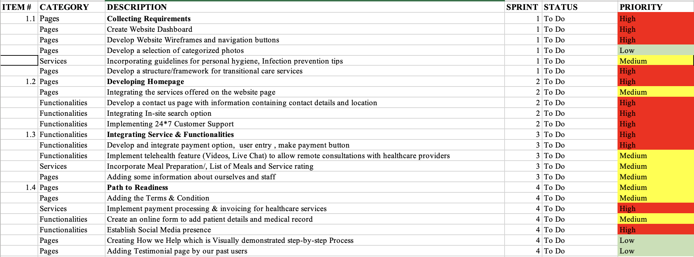
Sprint planning

Slide 18
resources
Product Manager | 01
Product Owner | 01
Scrum Master | 01
Developers - a) Full Stack b) Front End c) Back End d) UX | 04
Quality Manager | 01
Social Media Manager | 01

Slide 19
Communication Plan
Daily Stand-up at 9:00 am (for 15 min. max)
Weekly Meetings with all stakeholders on Thursdays on Zoom
Review Meeting fortnightly
All the stakeholders would be regularly updated through social media, blog post and emails

Slide 20

References
JIRA Cloud Tutorial [Video]. (n.d.). YouTube. https://www.youtube.com/watch?v=7aLVAyCWQIE
A. (n.d.). Product Backlog Explained [+ Examples] | Atlassian. Atlassian. https://www.atlassian.com/agile/scrum/backlogs
What is Scrum release planning? (n.d.). https://www.visual-paradigm.com/scrum/what-is-scrum-release-planning /

